Slide 1
Best Buys
EQ – How do I find the best buy?

Slide 2
Learning Objectives
To be able to use rates to find the best buy.

Slide 3
Best Buys EQ: How do I find the best buy?
Task -
James earns $15/hr. How much does he earn for an 8 hour shift?
Divide $100 in a ratio of 3 : 7.
What is the complement for the event – wearing a blue T-shirt?
If it cost $10 for 4 bars of chocolate. How much does it cost for 1?
If Michael earns $120 for a 6 hour shift. How much would he earn for a 4 hour shift?

Slide 4
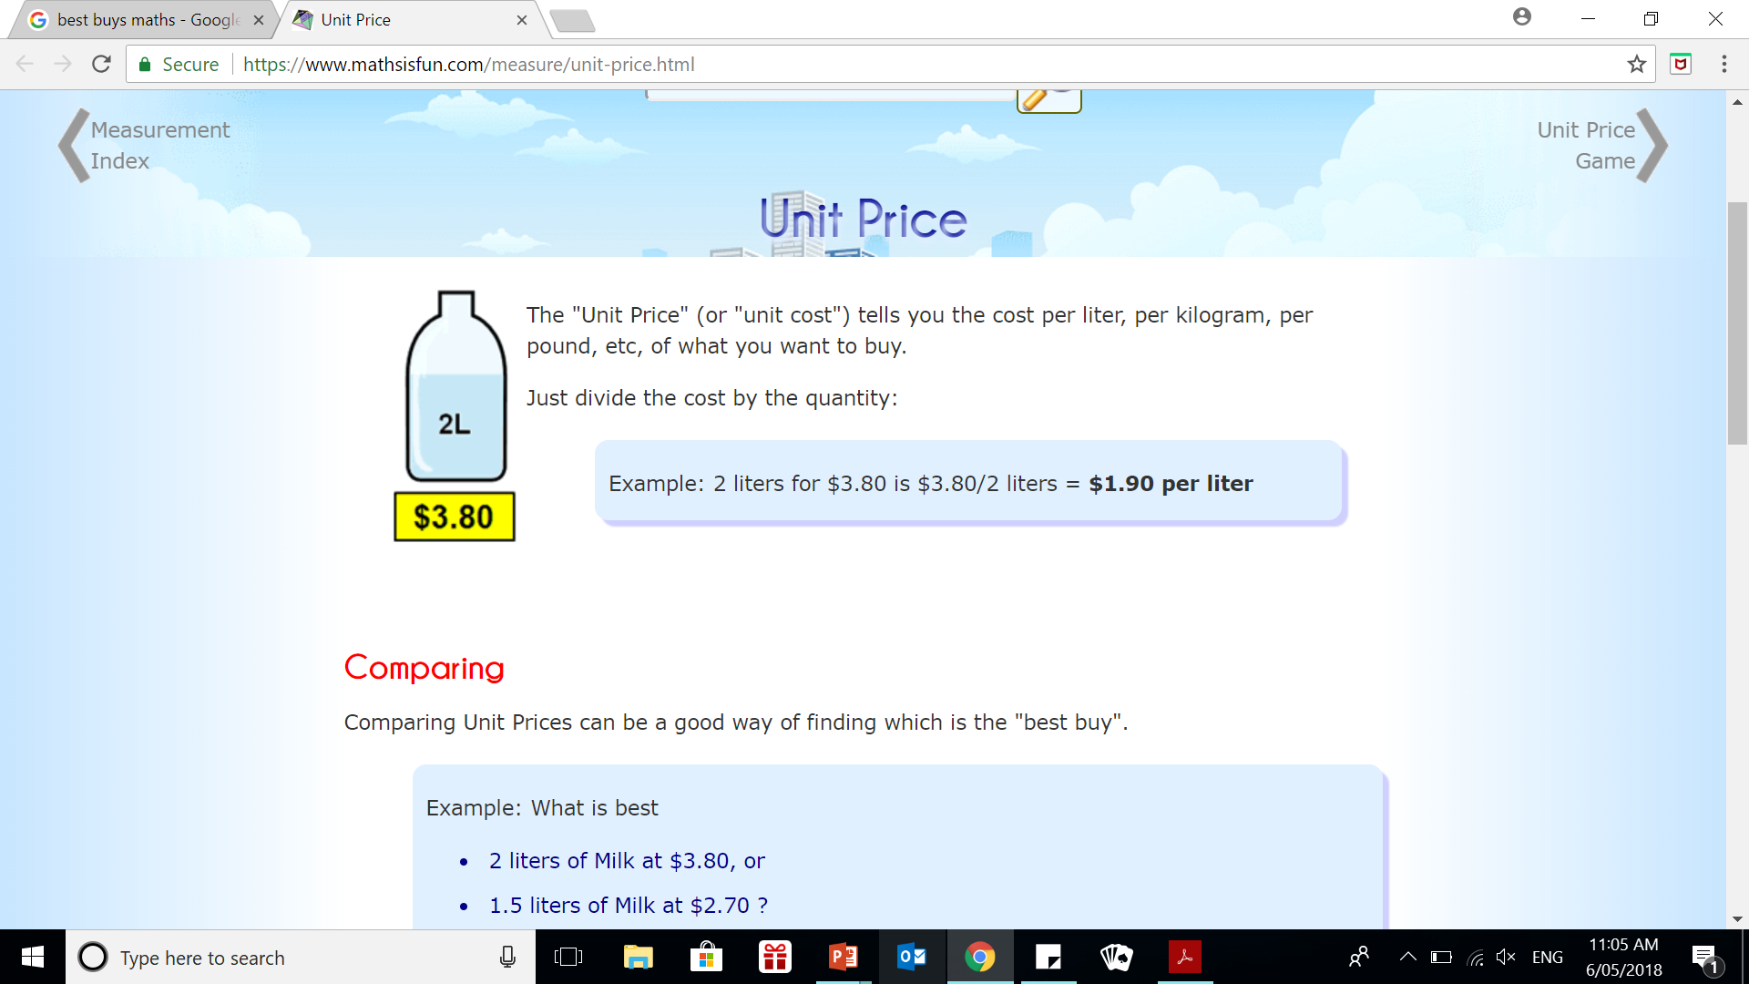
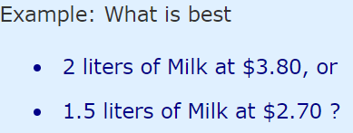

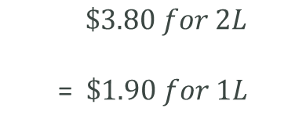



24, 7, 30
Writing
Rates
EQ – how do I find the best buy?
What is a unit price?
Best Buy
$\$3.80 for 2L$
= $\$1.90 for 1L$
Comparing Unit Price
Comparing Unit Prices can be a good way of finding which is the "best buy"
$$\$3.80 ÷ 2$$
$$=\$1.90 per Litre$$
$$=\$1.80 per Litre$$
$$\$2.70 ÷1.5$$

Slide 5
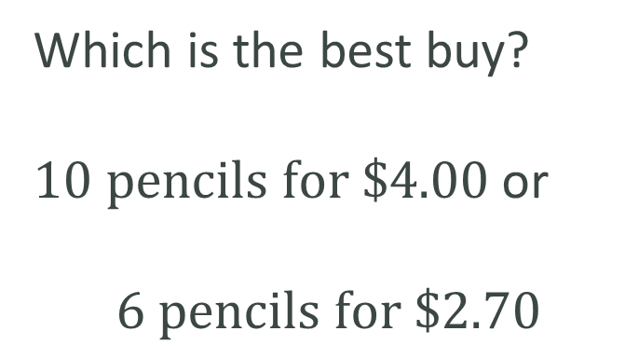
PRACTICE - TOGETHER
Which is the best buy?
$10 pencils for \$4.00$ or
$$6 pencils for \$2.70$$

Slide 6
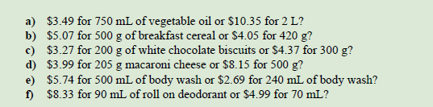
Your turn

Slide 7
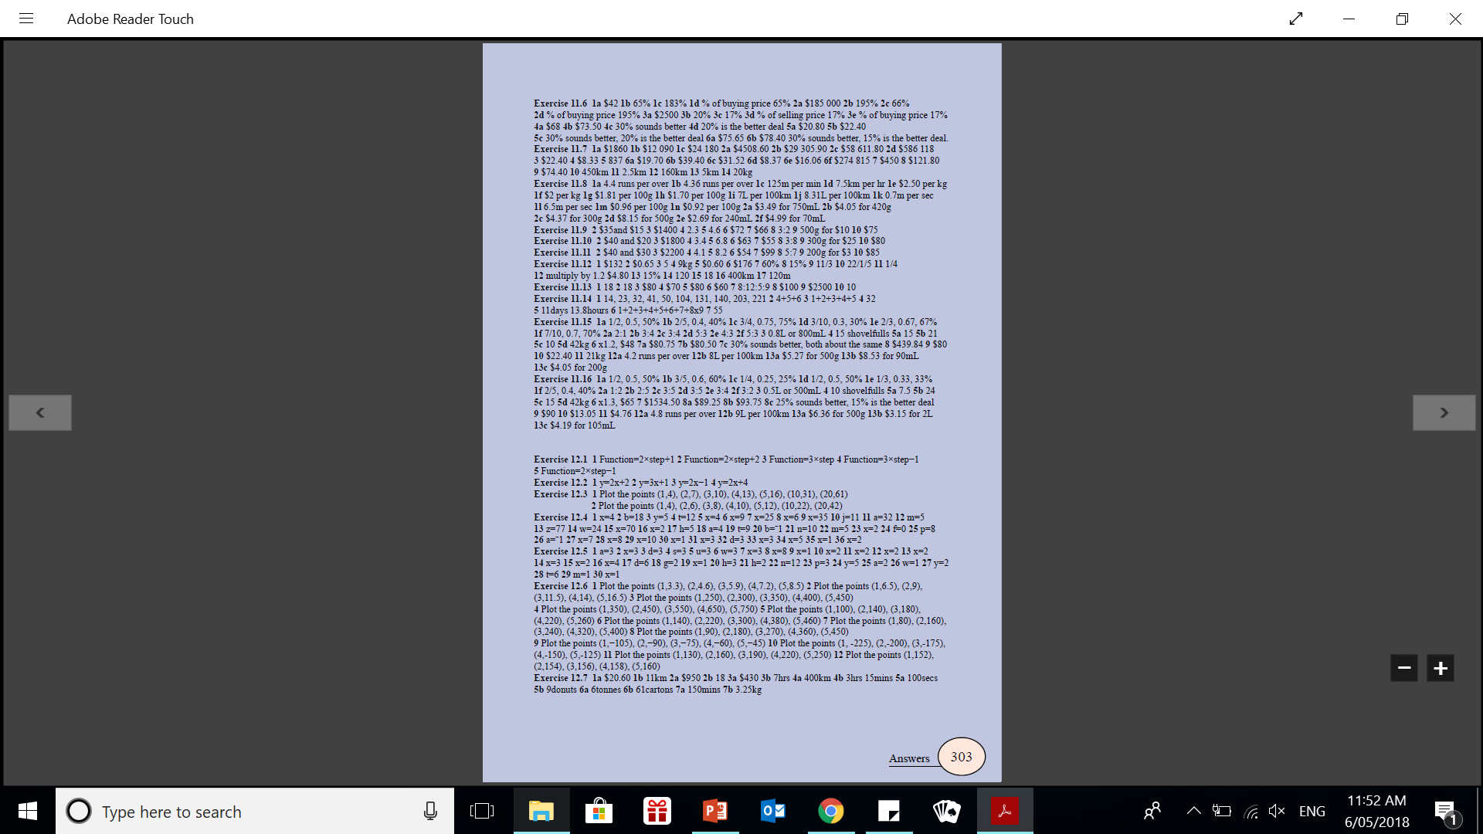
Your turn

